Slide 1

Major Project Review-I
Batch No: AA10
Project Title: DataSage AI: AI for Deep Data Insights & Exploration
S.No | Reg.No | Student Name
1 | 22A81A6122 | JAKKANI SREE TARAKA VAMSI KRISHNA
2 | 22A81A6160 | TIRUVEEDULA L.N.V.S.M.L.DHEERAJ
3 | 22A81A6115 | DAGULURI RAJU
4 | 22A81A6116 | DAMISETTI PRAGATHI LAKSHMI DEVI
5 | 22A81A6144 | NARAGANA KRISHNA SRI CHAITANYA
6 | 22A81A6127 | KALAVAKANTI BHAVYA NAGA SRI
Project Guide
Ms. Jane Rose

Slide 2
Major Project Review I - Contents
Abstract
Introduction
Literature Survey
Problem Statement in Existing System
Proposed System
Objectives
Project domain
Requirement analysis
- Functional Requirements
- Non-Functional Requirements
- Software Requirements
- Hardware Requirements
System Architecture
Methodology

Slide 3
Abstract
DataSage AI is a local, adaptive, and explainable assistant that transforms raw tabular data (CSV/Excel) into actionable insights—without cloud dependencies or machine learning models. Designed for non-technical users in privacy-sensitive domains (e.g., healthcare, education, small businesses), the tool leverages Python, FastAPI, Pandas, and Plotly to generate interactive visualizations, statistical summaries, and anomaly detection reports entirely offline. Its natural-language Q&A (powered by local LLMs like LLaMA 3 via Ollama) enables users to ask questions like “Why did sales drop in June?” and receive plain-English, data-driven answers. By prioritizing privacy, transparency, and adaptability to periodic data updates, DataSage AI bridges the gap between raw datasets and decision-making for domain experts.

Slide 4
Introduction
In many industries, structured datasets are underutilized due to the complexity of extracting actionable insights without advanced technical skills or costly cloud-based tools. Privacy concerns, internet dependency, and the need for explainable results make traditional analytics platforms unsuitable for sensitive environments. DataSage AI addresses these challenges by providing an offline-first, user-friendly, and adaptive solution that transforms tabular data into clear, interactive insights. It bridges the gap between raw data and informed decision-making, empowering users—regardless of technical expertise—to explore patterns, detect anomalies, and ask natural-language questions with transparent, explainable answers.

Slide 5
Literature Survey
S.No | Paper Title | Authors / Year | Key Contributions | Techniques / Frameworks | Relation to Your Project
1 | Local AI: On-Device Machine Learning for Data Privacy | Lane et al. (2015) | Discusses benefits and architectures for running ML on local devices | On-device inference, edge computing | Validates your “runs locally and offline” approach for privacy-sensitive data analysis
2 | Plotly: An Open-Source Graphing Library for Interactive Data Visualization | Inc. Plotly Technologies (2015) | High-quality, interactive visualizations for web apps | Plotly.js, Dash | Matches your interactive charting and in-chat visualization editing features
3 | Towards Automatic Data Cleaning: An End-to-End Framework | Chu et al. (2016) | Automatic detection & correction of data errors | FAHES, Holistic data cleaning pipelines | Aligns with your preprocessing phase for datasets before visualization and analysis
4 | Retrieval-Augmented Generation for Knowledge-Intensive NLP Tasks | Lewis et al. (2020) | Combines retrieval with generative models for better factual accuracy | RAG architecture | Aligns with your AI Q&A feature using structured/unstructured data
5 | QUIS: Question-guided Insights Generation for Automated EDA | Manatkar et al., 2024 | Two-stage system: question generation (QUGEN) → statistical insight generation (ISGEN); no training required; defines scoring functions (Trend, Outstanding Value, Attribution, Distribution Difference). | LLM-driven iterative question generation; statistical tests (e.g., Mann-Kendall); classical search over views; insight cards & thresholds | Direct blueprint for your system; you can plug in new insight types (outlier, anomaly, predictive, reversal) into ISGEN and extend QUGEN iteration policy.

Slide 6
Problem Statement in Existing System
In the current landscape, most data analysis solutions are heavily dependent on cloud infrastructure, making them unusable in offline or restricted environments and exposing sensitive datasets to privacy risks. These platforms often have a steep learning curve, requiring advanced technical skills that non-expert users may not possess. Furthermore, insights generated by existing systems are frequently presented as black-box outputs, lacking the transparency and explainability needed for informed decision-making. The workflow is fragmented, with data profiling, visualization, anomaly detection, and reporting spread across multiple tools, resulting in inefficiency and higher manual effort. Additionally, many systems provide static insights that fail to adapt when datasets are updated, leaving users without timely or context-aware analysis.

Slide 7
Proposed System
The proposed system, DataSage AI, addresses these limitations by offering a fully local, adaptive, and explainable AI assistant for tabular data analysis. Built with Python, FastAPI, Pandas, and Plotly, it operates entirely offline, ensuring complete data privacy and making it suitable for sensitive domains such as healthcare, education, agriculture, and small businesses. The system automates data profiling, visualization, anomaly detection, and pattern discovery, presenting results in interactive dashboards with clear, human-readable explanations. Unlike static solutions, DataSage AI dynamically adapts to periodic dataset updates, ensuring that insights remain relevant and up to date. It also supports natural-language queries—allowing users to ask questions like “Why did revenue drop last quarter?”—and provides context-aware, transparent answers grounded in the actual data. By combining usability, adaptability, and trust, DataSage AI delivers an all-in-one, offline-first analytics solution without requiring cloud infrastructure or advanced technical expertise.

Slide 8
Objectives
Automate Insight Generation: Deliver automated data profiling, visualization, anomaly detection, and pattern discovery without manual intervention.
Improve Explainability: Offer transparent, plain-language explanations for all insights to build trust and support informed decision-making.
Enable Adaptability: Automatically update analyses and summaries when datasets are modified or replaced.
Unify Workflow: Integrate multiple data analysis steps into a single platform, eliminating the need for separate tools.
Support Multiple Domains: Tailor the solution for diverse sectors such as healthcare, agriculture, education, and small business.

Slide 9
Objectives
Ensure Data Privacy: Provide a completely offline solution to safeguard sensitive datasets from cloud exposure.
Enhance Accessibility: Enable non-technical users to perform advanced data analysis through an intuitive interface and natural-language queries.

Slide 10
Project Domain

Slide 11
Requirement Analysis
1. Functional Requirements
Upload and process structured datasets (CSV, XLSX).
Perform automated data profiling (statistics, summaries).
Generate interactive visualizations (charts, graphs).
Detect anomalies and hidden patterns.
Support natural-language question answering about the dataset.
Provide plain-language explanations for insights.
Update insights dynamically when datasets change.
Export reports in multiple formats (PDF, Excel).

Slide 12
Requirement Analysis
2. Non-Functional Requirements
Offline Capability: System must function without internet connectivity.
Performance: Process datasets up to a defined size limit within a few seconds.
Usability: Simple, intuitive UI accessible to non-technical users.
Scalability: Ability to handle increasing dataset sizes efficiently.
Security: Ensure complete data privacy by preventing cloud upload.
Maintainability: Modular code structure for easier updates and enhancements.

Slide 13
Requirement Analysis
3. Software Requirements
Backend: Python, FastAPI
Libraries: Pandas, Plotly, NumPy, Scikit-learn (for anomaly detection), Optional LLM via Ollama
Frontend: React.js (or HTML/CSS/JavaScript if standalone)
Database: MongoDB (for metadata storage)
Environment: Local machine / server with Python 3.10+

Slide 14
Requirement Analysis
4. Hardware Requirements
Minimum:
Processor: Dual-core CPU (2 GHz or higher)
RAM: 4 GB
Storage: 100 GB free space
Recommended:
Processor: Quad-core CPU (3 GHz or higher)
RAM: 8 GB or more
Storage: 256 GB free space
GPU (Optional) for faster LLM inference

Slide 15
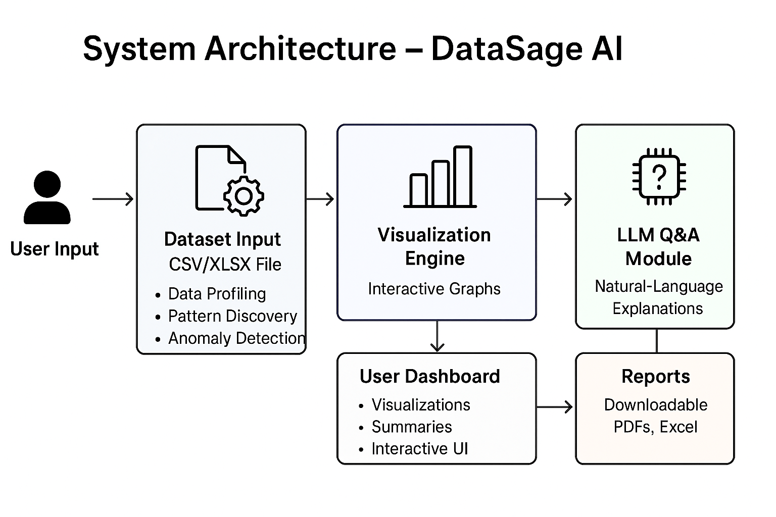
System Architecture

Slide 16
Methodology
DataSage AI follows a structured, modular approach to ensure robustness, adaptability, and ease of deployment in offline environments
1. Data Ingestion and Preprocessing
Input Handling: The system accepts structured datasets in formats such as CSV and Excel.
Validation: Checks for schema consistency, missing values, and format errors.
Cleaning & Transformation: Handles missing data (imputation or removal), removes duplicates, normalizes column names, and converts data types for uniform processing.

Slide 17
Methodology
2. Data Profiling and Summary Generation
Descriptive Statistics: Calculates mean, median, mode, variance, standard deviation, and data distribution.
Automated Profiling: Generates summaries of dataset dimensions, data types, and null value percentages.
Correlation Analysis: Identifies relationships between variables using correlation matrices and visual heatmaps.

Slide 18
Methodology
3. Insight Extraction and Anomaly Detection
Pattern Discovery: Identifies trends, seasonal effects, and recurring patterns.
Anomaly Detection: Detects outliers and unusual data points using statistical and rule-based methods.
Dynamic Summaries: Updates insights automatically when new data is loaded.

Slide 19
Methodology
4. Visualization Layer
Interactive Charts: Uses Plotly to generate dynamic and interactive bar charts, line graphs, scatter plots, and heatmaps.
Custom Dashboards: Allows users to filter, zoom, and highlight specific data ranges for deeper exploration.
5. Natural Language Query & Explainable AI
Local LLM Integration: Enables question-answering using locally hosted models (e.g., LLaMA 3 via Ollama) without internet dependency.
Explainable Responses: Provides step-by-step reasoning and visual evidence for each answer, improving transparency.

Slide 20
Methodology
6. User Interaction and Adaptation
Context-Aware Responses: Adapts to the user’s query style and domain-specific terminology.
Periodic Updates: Maintains relevance by refreshing insights whenever new datasets are added.
7. Deployment and Security
Offline-first Architecture: Designed for environments with limited or no internet access.
Data Privacy: All processing is performed locally to safeguard sensitive data.
Scalable Backend: FastAPI serves as the API layer, ensuring efficient data handling and visualization delivery.

Slide 21
THANK YOU

